Slide 1
Body Fat Project
Group two

Slide 2
Summary of Data Cleaning
We delete ten individuals due to missing value
We remove ten outliers based on Z-score
We correct a body fat based on the corresponding density
Final Cleaned Data: n=242 with p=14
Predictors: age, weight, height, adiposity, neck, chest, abdomen, hip, thigh, knee, ankle
 | IDNO | BODYFAT | DENSITY
Original Observation | 182 | 0 | 1.1089
Updated Observation | 182 | 4.06454 | 1.1089

Slide 3
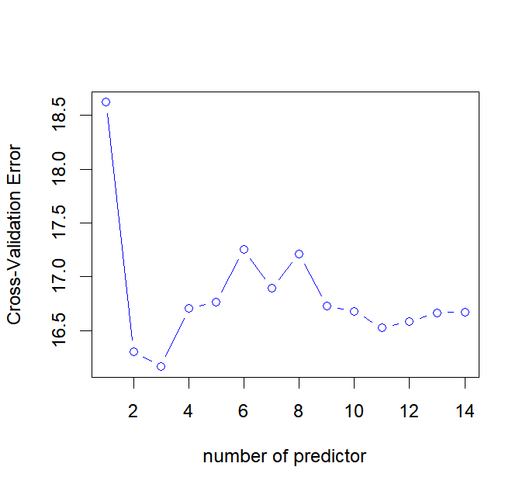
Linear Model
Linear Regression:
Use best subset selection to identify the best model for each subset size
Select a single best model using cross validated prediction error
Height
Abdomen
Wrist

Slide 4
Finding the Best Model for Body Fat
Candidate Models:
Linear Model: Linear Regression, Lasso Regression, Principal Component Regression
Nonlinear Model: Decision Tree, Random Forest
Metric for Model Performance:
MSE, R2

Slide 5
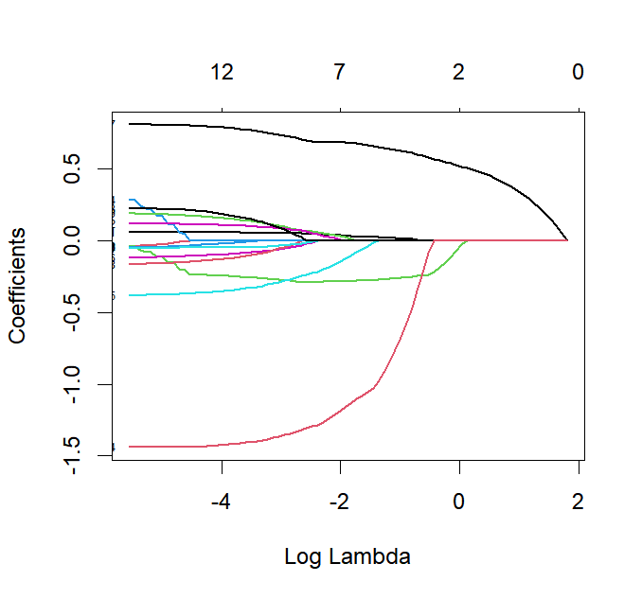
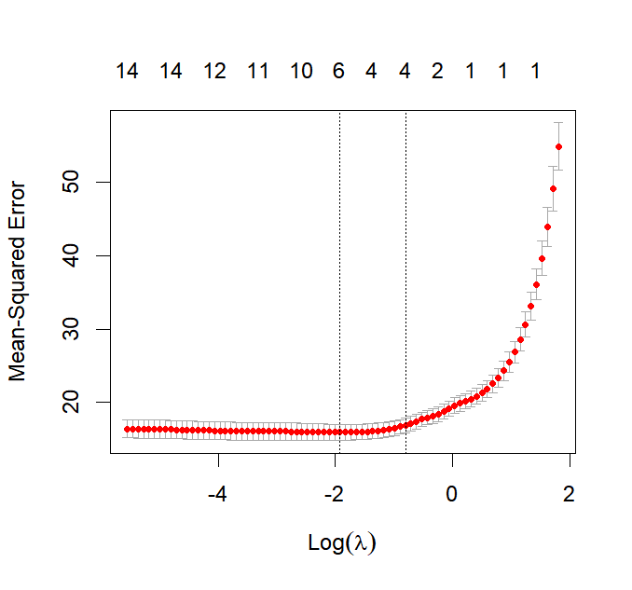
The Lasso
Use cross validation to select the best lambda and based on the one-standard-error rule chose a bigger lambda to reduce the variance of the model
Age
Height
Abdomen
Wrist

Slide 6
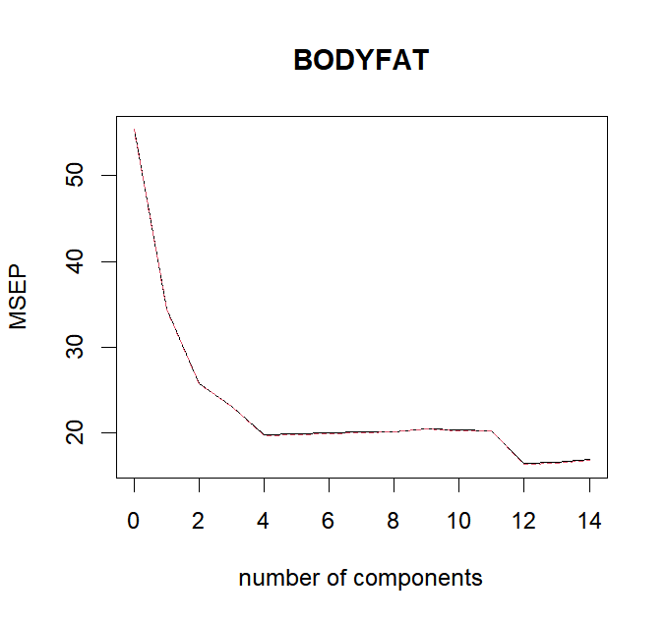
The Principal Components Regression Approach
Use cross validation to select a appropriate number of principal components which is four

Slide 7
Nonlinear Model - Decision Tree
Model: Utilized R’s rpart function to construct a decision tree model.
Feature Selection: ‘Height’, ‘Abdomen’, and ‘Wrist’ were identified as the most important predictors based on the decision tree’s feature importance.
Cross-Validation: Implemented k-fold cross-validation for a more reliable performance estimation.
Performance Metrics: Computed Mean Squared Error (MSE) and R-squared values to assess the model’s accuracy.
MSE:22.7793
R-square:0.5843

Slide 8
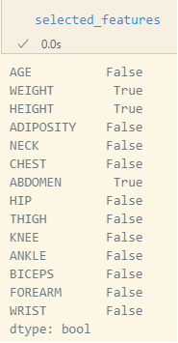
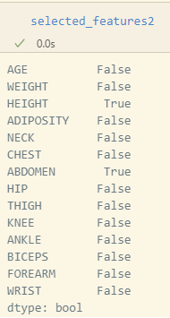
Nonlinear Model - Random Forest
Random Forest can model non-linear relationships and interactions between variables effectively.
RFE (Recursive Feature Elimination): removes the weakest feature until the specified number of features is reached.

Slide 9
Result
Model | R^2 | MSE
Linear regression | 0.7160 | 15.6092
Lasso | 0.6996 | 16.5052
PCR | 0.6577 | 18.8090
Decision Tree | 0.5843 | 22.7793
Random Forest | 0.6072 | 23.27

Slide 10
Final Model
Bodyfat = 6.1683 - 0.1538 * Height +0.7228 * Abdomen - 1.4684 * Wrist
Description:
For every unit increase in height, the body fat percentage is expected to decrease by 0.1538%.
For every unit increase in the abdomen measurement, the body fat percentage is expected to increase by 0.7228%.
For every unit increase in wrist measurement, the body fat percentage is expected to decrease by 1.4684%

Slide 11
Discussion of Results
From results above, we find the performance of linear models are better than that of nonlinear models.
Among linear models, we see that the linear regression has the highest R^2 and lowest MSE. Therefore considering the trade-off between simplicity and accuracy, we choose linear regression as our final model.

Slide 12
Statistical properties:
Coefficient abdomen, height, and wrist are all significant at 0.05 on two-sided t-test with p-value < 2e-16, 0.000429, and 0.000157 respectively.
Overall model is significantly at 0.05 based on F-test with p-value < 2.2e-16.
Abdomen has a positive correlation with body fat, but height and wrist has a negative correlation with body fat.
R^2 = 0.7160, MSE = 15.6092, and estimated test error is 16.1673

Slide 13
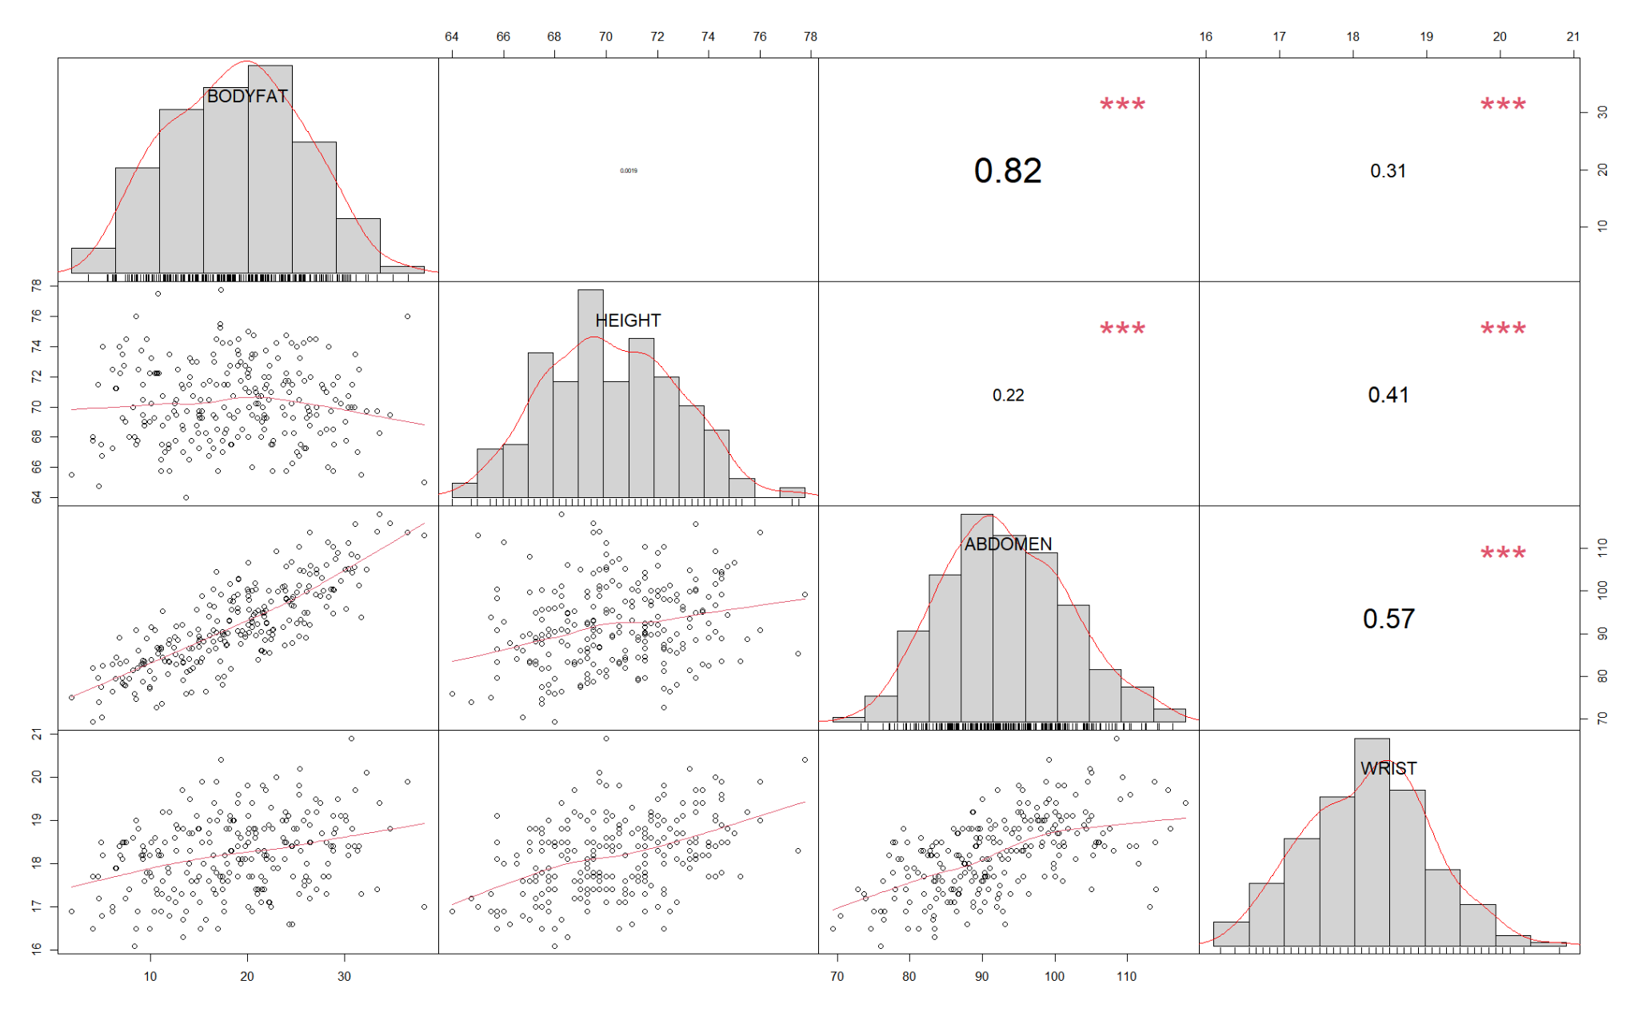

Slide 14
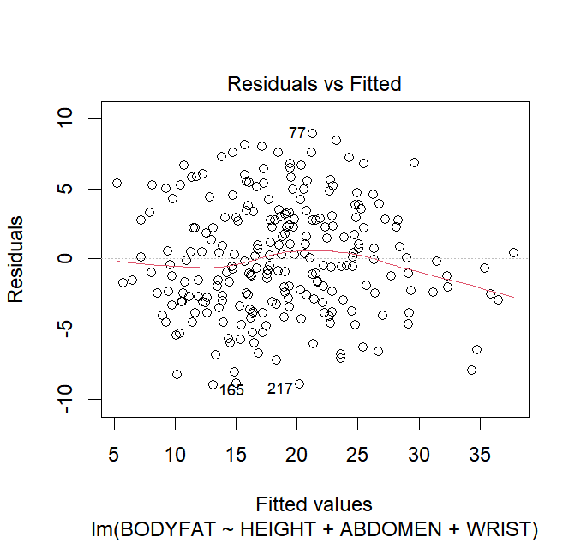
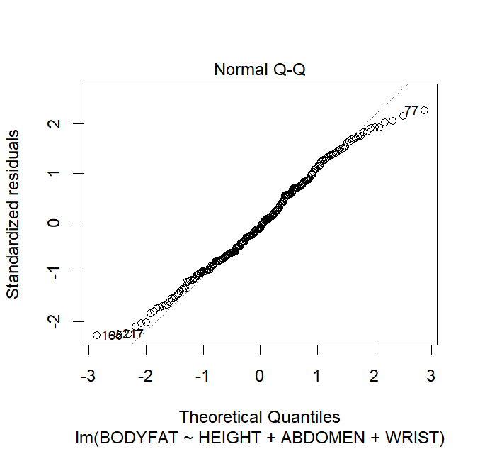
Model Diagnostics
Residual Plot
QQ Plot

Slide 15
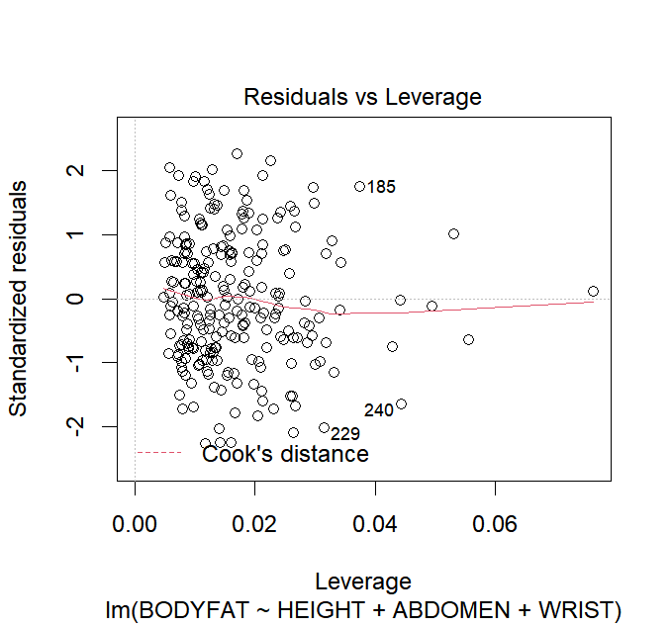

Slide 16
Strengths and Weaknesses
Strengths:
The model is simple and easy to interpret
The model explains 71.6% of variation in body fat
Weaknesses:
The model exhibits multicollinearity, which can lead to unstable coefficients and a decrease in prediction accuracy.
In the subsequent steps, we consider using combined variables or principal component analysis to address this issue.

